Slide 1
UMWM
C S E 4 6 5 — PAT T E R N R E C O G N I T I O N & N E U R A L N E T W O R K S
Unified Multimodal World Model
A single shared encoder–decoder architecture that fuses image, audio, text, and video into one latent space — generating language from any modality and predicting future world states.
G R O U P M E M B E R S
1 Md. Miraz Ihsan Chowdhury
ID: 2131407642
2 Jannatul Ferdaus Mim
ID: 2311593042
3 Tasfiah Hossain Lamia
ID: 2231699042

Slide 2
One model, four senses, one shared mind
0 1 · P R O J E C T T O P I C
UMWM (Unified Multimodal World Model) explores whether a single, compact neural network can learn one shared representation for four very different data types — image, audio, text, and video — instead of training a separate model per modality.
IMAGE
CIFAR-10 photo
AUDIO
Synthetic spectrogram
Every sample is first mapped into a common latent space. From that single space the model can reconstruct images, generate a natural-language caption from any input modality, classify the object, and even “imagine” — roll forward — future states of the scene. This last piece is what makes it a world model, not just a multimodal encoder.
SHARED LATENT SPACE
TEXT
Caption tokens
VIDEO
Pan / zoom clip
W H Y I T M AT T E R S
Real-world agents perceive the world through many channels at once. A shared latent space is a step toward AI that reasons about a scene the way it looks, sounds, is described, and moves — all together.
02

Slide 3
What we set out to find — and confirmed
0 2 · O B J E C T I V E S
1
Unify four modalities in one latent space
2
Generate captions from any modality
Trained one shared encoder — not four separate ones — so image, audio, text, and video representations of the same class land near each other in a 128-d latent space, confirmed visually with t-SNE.
A single text decoder produces natural-language descriptions whether the input was a photo, a spectrogram, a caption, or a video clip, without needing a modality-specific decoder.
3
Support cross-modal retrieval
4
Predict future states — the “world model”
Measured how well the shared latent space lets one modality query and retrieve the matching sample in another (e.g. audio → image), a strong proxy for genuine multimodal alignment.
Added a dynamics network that rolls a latent vector forward in time and decodes it back to pixels, letting the model “dream” plausible future frames from a single starting image.
03

Slide 4
Where UMWM sits among existing ideas
0 3 · R E L AT E D W O R K
CLIP
(Radford et al., 2021)
Similar: Uses the same NT-Xent contrastive loss to pull matching pairs together in a shared space.
Different: Only 2 modalities (image, text); no reconstruction and no decoder — UMWM adds audio + video and a generative decoder.
Contrastive image–text alignment
ImageBind (Meta, 2023)
Similar: Same core idea: bind many modalities into a single joint embedding space.
Different: ImageBind is a large pretrained contrastive-only model; UMWM is a compact VAE-based model trained from scratch with reconstruction + generation.
One embedding space for 6 modalities
World Models / Dreamer
(Ha & Schmidhuber; Hafner et al.)
Similar: Same VAE + latent dynamics recipe: encode observations, learn a GRU that rolls the latent state forward.
Different: Original world models are single-modality (vision) and RL-driven; UMWM's dynamics module operates over a multimodal shared latent instead.
Latent dynamics for planning & “dreaming”
04

Slide 5
Turning CIFAR-10 into four aligned modalities
0 4 · M E T H O D S — D ATA
Every one of the four modalities is derived from the same CIFAR-10 image, so every sample carries one label and four consistent, aligned views of it.
IMAGE
AUDIO
TEXT
VIDEO
Base signal: the original CIFAR-10 photo (32×32, 3 channels, 10 classes — airplane, automobile, bird, cat, deer, dog, frog, horse, ship, truck).
Synthetic mel-spectrograms with a per-class acoustic “signature” (frequency, bandwidth, pattern) plus per-sample randomization, so the task has real intra-class variance instead of a fixed lookup.
Captions built from 10 templates (e.g. “a photo of a {}”, “a {} captured on camera”) filled with the class name, then tokenized against a custom vocabulary.
4-frame clips synthesized from the still image with a smooth pan / zoom / rotation trajectory — giving genuine frame-to-frame continuity rather than repeated static frames.
10,000 test samples × 4 modalities encoded for evaluation • vocabulary built only from the caption templates + class names
05

Slide 6
One shared encoder, four modality-specific doors
0 4 · M E T H O D S — M O D E L & P I P E L I N E
Visual Decoder
Text Decoder
Dynamics Model
Classifier
Modality Tokenizers
CNN (image/audio/video) GRU (text)
Shared Encoder (VAE)
μ, logσ² → z (latent dim 128)
z
Reconstructs image / audio / video frame
Autoregressive GRU → caption
GRU rolls z forward
* future states
Predicts class from z
4 modality-specific tokenizers all feed the SAME shared VAE encoder — one set of weights learns every modality at once.
TRA I NI NG CU RRI C ULUM — 4 SEQU E NT I AL PHA SES
P1 VAE Reconstruction
P2 Contrastive Alignment
P3 Text Decoder
P4 Dynamics / World Model
30 epochs
20 epochs
20 epochs (encoder frozen)
15 epochs (rest frozen)
Recon loss: 0.7326
NT-Xent loss: 2.9899
Cross-entropy: 0.4355
MSE: 0.6265
Total trainable parameters: 3,492,977
06

Slide 7
Text and audio anchor the shared space best
0 5 · R E S U LT S — Q U A N T I TAT I V E
Classification accuracy per modality Cross-modal retrieval accuracy (Top-1)
100.0% 100.0%
100%
93.9%
Query → Gallery | Top-1 | Top-5
image → audio | 66.1% | 67.3%
image → text | 65.9% | 67.2%
image → video | 64.6% | 77.5%
audio → image | 80.0% | 100.0%
text → image | 77.0% | 100.0%
video → image | 70.7% | 98.4%
audio / text / video ↔ each other | 94–100% | 94–100%
90%
80%
70%
60%
50%
66.3%
40%
30%
20%
10%
0%
Image
Audio
Text
Video
Reading the numbers: audio and text sit almost perfectly on top of each other in the latent space (100% mutual retrieval), because both are generated directly from the class label. Image is the hardest anchor — its higher intra-class visual variance means retrieval from image drops to 65–80%, while video (a motion-augmented image) sits in between.
07

Slide 8
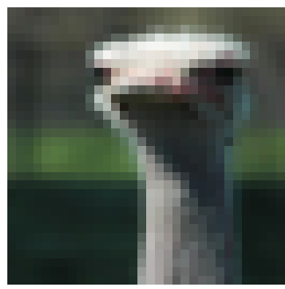
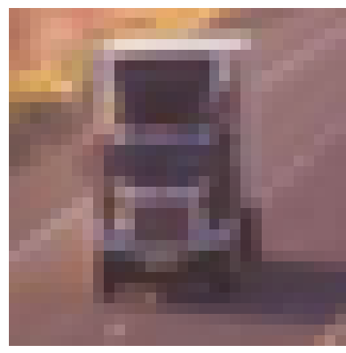
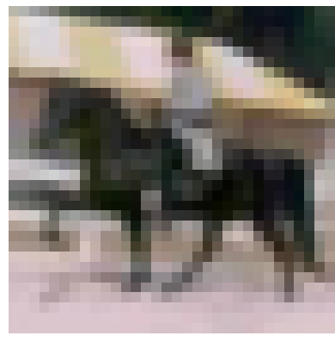
One text decoder, any modality in
0 5 · R E S U LT S — Q U A L I TAT I V E
Real CIFAR-10 test images — captions generated purely from their encoded image, audio, and video latents. The model never sees caption text at inference time.
BIRD
TRUCK
HORSE
Image: a photo of a bird
Image: a small cat photograph
Image: a horse captured on camera
Audio: a bird in the wild
Audio: a truck captured on camera
Audio: a horse captured on camera
Video: a bird in the wild
Video: a truck captured on camera
Video: a horse captured on camera
Center example: the image-only path misreads “cat,” yet audio and video — sharing the same latent space — both recover the correct label, showing the extra modalities add real robustness, not just redundancy.
100%
Audio & text accuracy
93.9%
Video accuracy
3.49M
Trainable parameters
6 steps
“Dream” frames per rollout
07

